Slide 1
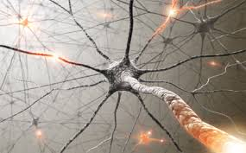
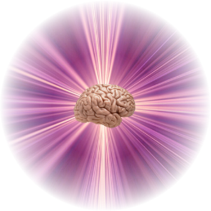
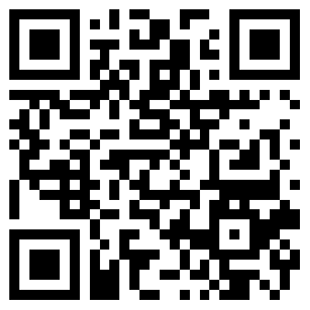
Associative Fine-Tuning of Biologically Inspired Active Neuro-Associative Knowledge Graphs
Adrian Horzyk
horzyk@agh.edu.pl
Google: Horzyk
Janusz A. Starzyk
starzykj@ohio.edu
Google: Janusz Starzyk
AGH University of
Science and Technology
Krakow, Poland
Ohio University, Athens, Ohio, U.S.A., School of Electrical Engineering and Computer Science
University of Information Technology and Management, Rzeszow, Poland
Notes:
This talk will be about an improved algorithm for fine-tuning of biologically inspired Active Neuro-Associative Knowledge Graphs that can be adapter to represent and contextually associate a set of sequences.

Slide 2
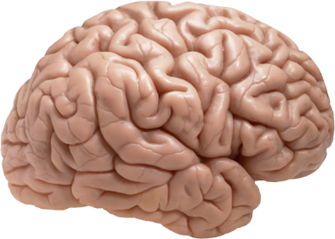
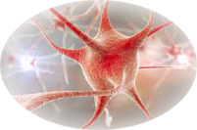
Research inspired by brains and biological neurons
Work in parallel and asynchronously
Associate stimuli context-sensitively
Use time approach for computations
Represent various data and their relations
Self-organize neurons developing a very complex structure
Aggregate representation of similar data
Integrate memory and the procedures
Provide plasticity to develop a structure to represent data and object relations
Notes:
Our research was inspired by biological neurons which …

Slide 3
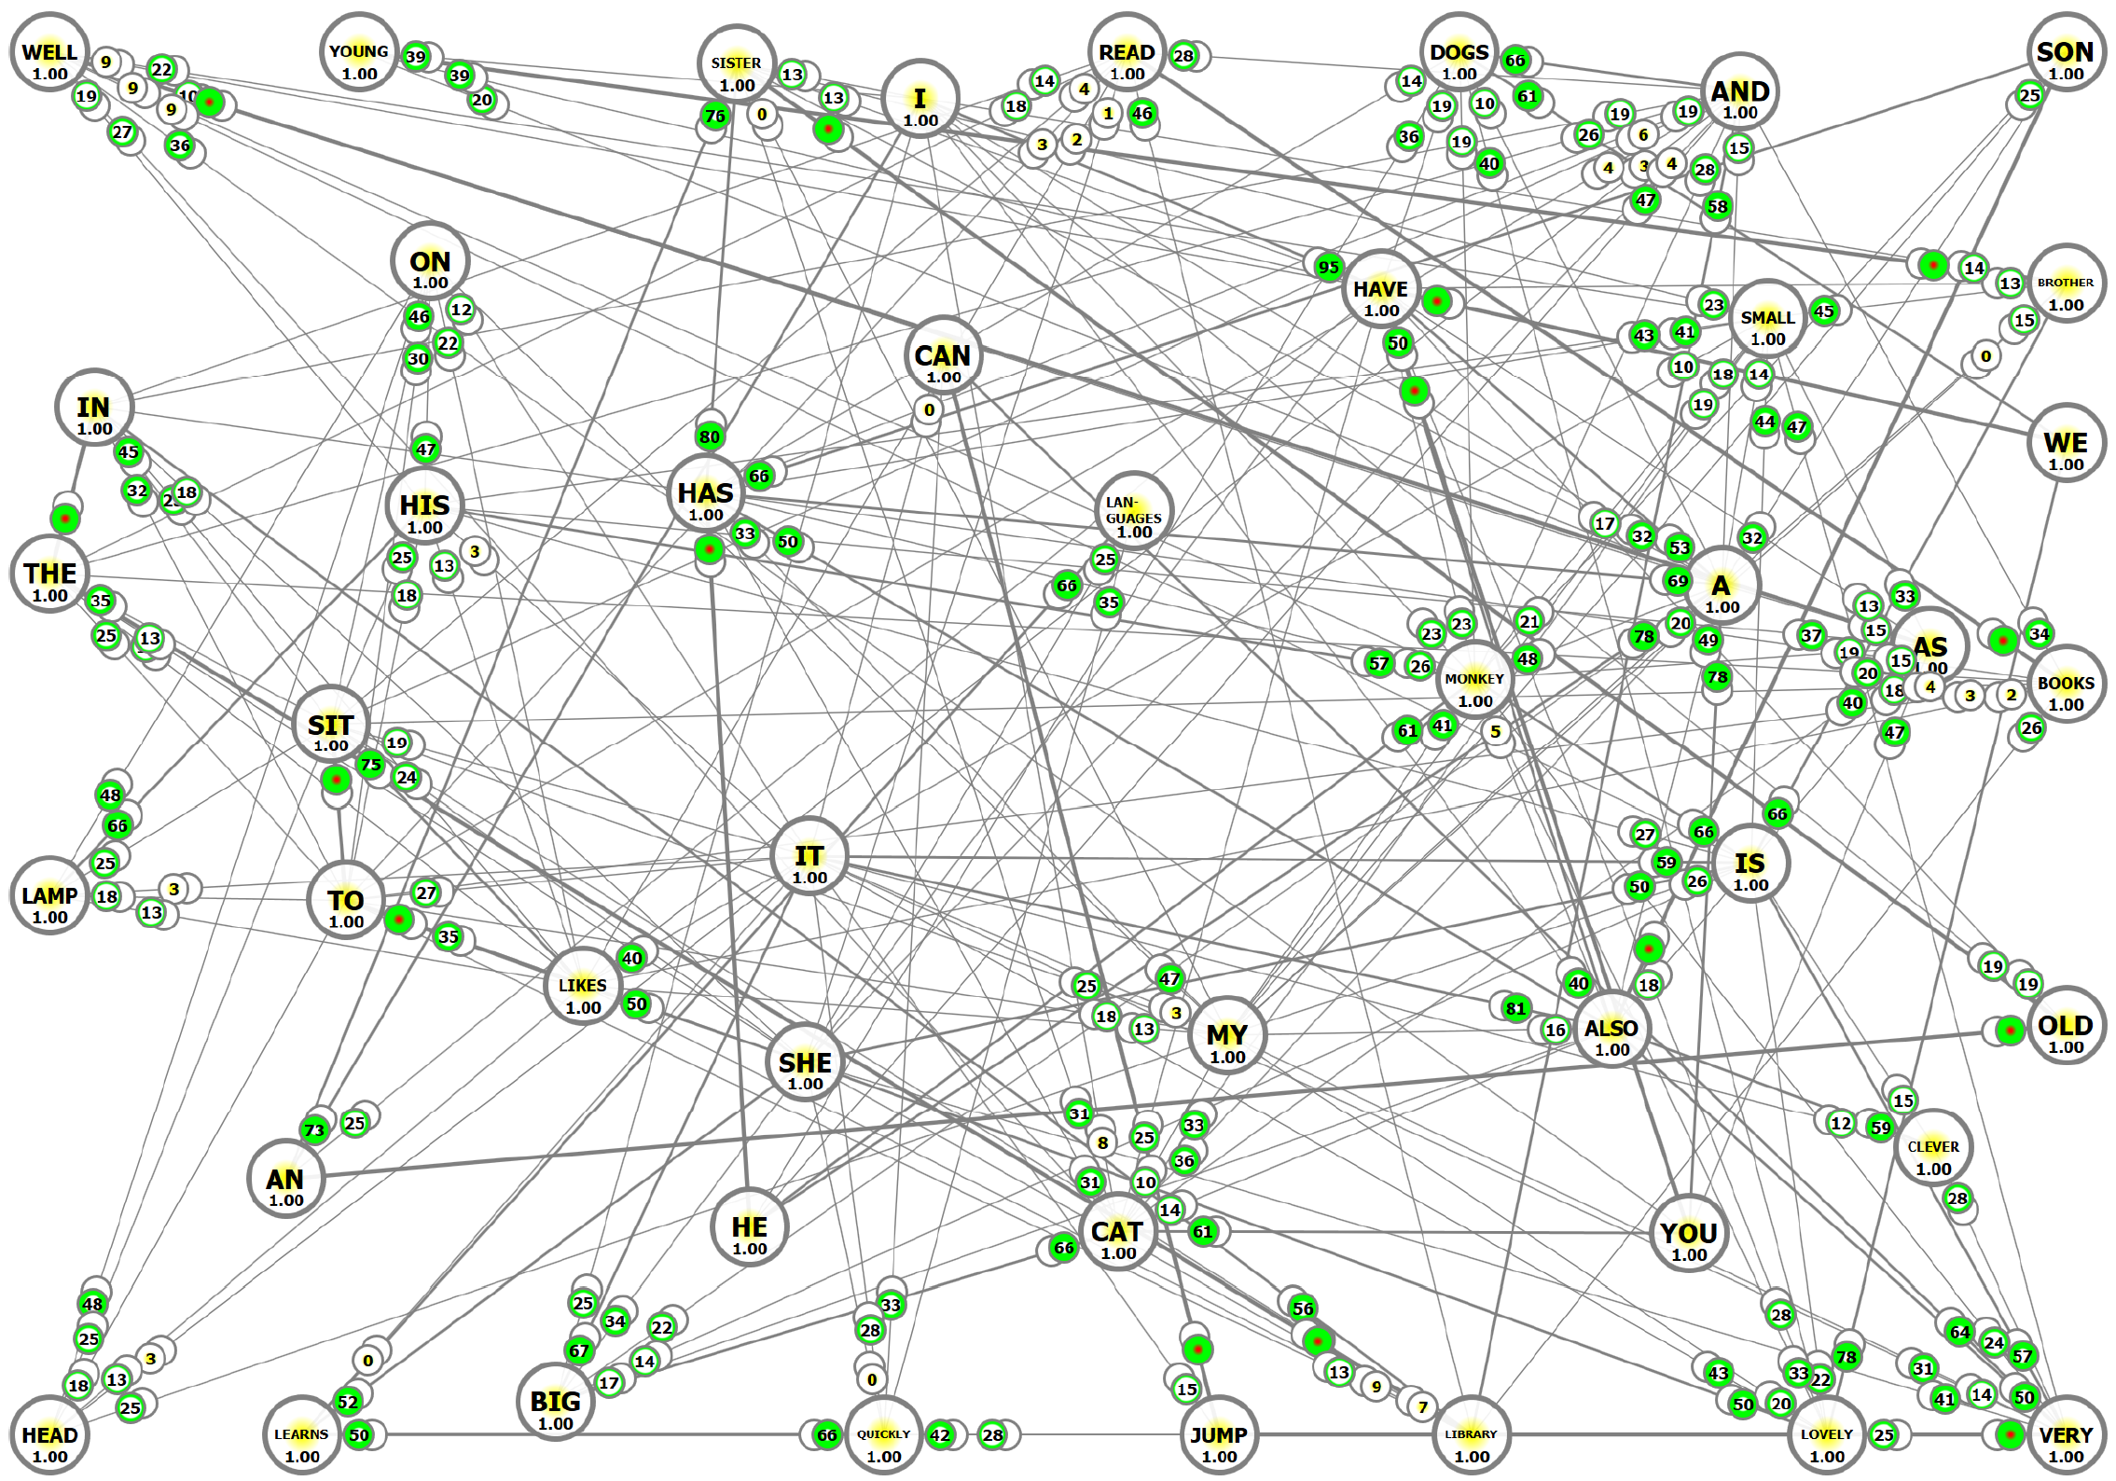
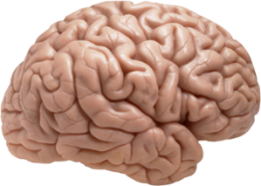
ACTIVE NEURO-ASSOCIATIVE KNOWLEDGE GRAPHS (ANAKG)
ANAKG produces a complex graph structure of dynamic and reactive neurons and connections to represent a set of training sequences.
Neurons aggregate all instances of the same elements that occur in all sequences.
Notes:
In the figure, we can see an exemplary ANAKG network that is a dynamic graph of connected neurons where neurons represent words, and connections represent sequence and context relations between them.

Slide 4
Objectives and Contribution
Construction of the fine-tuning algorithm for synaptic weights to achieve better recalling of associatively stored training sequences and better generalization.
Avoid unintended activations to stop possible false-recalling of sequences.
Construct a well-aggregative model for storing correlated training sequences.
Reproduce functionality of the biological neural substance.
Notes:
Our objectives were to construct …

Slide 5
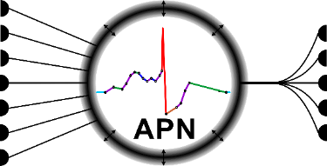
ASN Neurons
Connect context-sensitively to emphasize training sequences and automatically develop an ANAKG network structure.
Aggregate representations of the same elements of the training sentences - no duplicates!
Work asynchronously in parallel because time influences the results of the ANAKG network.
Integrate memory and associative processes
GOAL: Reproduce functionality of the biological neural substance!
Notes:
Associative Spiking Neurons developed in our previous studies connect …

Slide 6
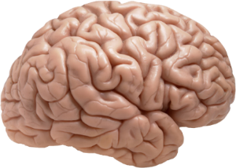
Associative Spiking Neurons ASN
Were developed to reproduce plasticity and associative properties of real neurons that work in time.
They implement internal neuronal processes (IP) and efficiently manage their processing using internal process queues (IPQ) and a global event queue (GEQ).
ASN neurons are updated only at the end of the internal processes (not continuously) to provide efficiency of data processing!
Notes:
They reproduce plasticity processes and associative properties of real neurons that work in time. We model internal processes using ….

Slide 7
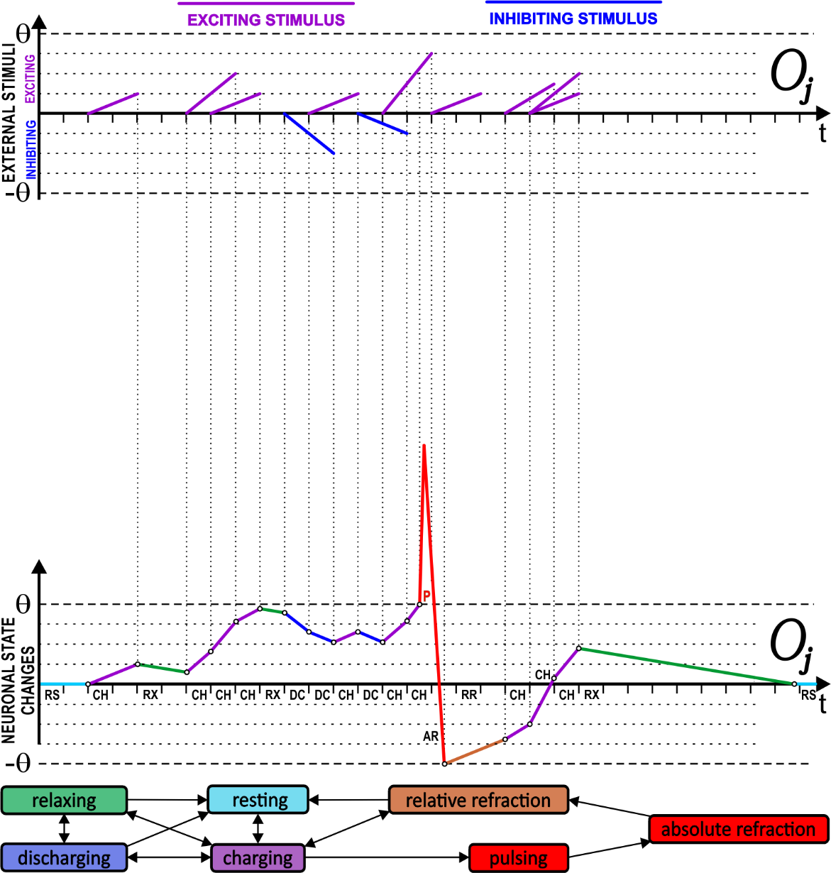
How ASN neurons work and how they are modeled?
IPQ represents a short sequence of internal changes of a neuronal state dependent on the external stimuli and previous internal states of the neuron.
Internal states of ASN neurons are updated only at the end of internal processes (IP) that are supervised by the Global Event Queue (GEQ).
Notes:
Internal states and processes of Associative Spiking Neurons are updated only at their end what make their simulation very fast in comparison to other spiking models of neurons. We also use the Global Event Queue to control and order these processes in time in the whole network.

Slide 8
Model and Adaptation of Associative Spiking Neurons
Synaptic efficacy defines the efficiency of the synapsis of the stimulations and spiking reactions of the postsynaptic neurons:
It depends on:
$∆t^{A}$ - the period of time that lapsed between the stimulation of the synapse between the $N_{m}$ and $N_{m+r}$ neurons and the activation of the postsynaptic neuron $N_{m+r}$ during training of the training sequence set $𝕊=\left\{S^{1},…,S^{N}\right\}$;
$∆t^{C}$ - the period of time necessary to charge and activate the postsynaptic neuron $N_{m+r}$ after stimulating the synapse between the $N_{m}$ and $N_{m+r}$ neurons (here $∆t^{C}$);
$∆t^{R}=200ms$ - the maximum period of time during which the postsynaptic neuron $N_{m+r}$ recovers and returns to its resting state after its charging that was not strong enough to activate this neuron;
$θ_{N_{m+r}^{n}}=1$ - the activation threshold of the postsynaptic neuron $N_{m+r}$;
$τ=4$ - the context influence factor changing the influence of the previously activated and connected neurons on the postsynaptic neuron $N_{m+r}$.
How do neurons work?
Notes:
The fundamental part of the Associative Spiking Neuron model is the definition of synaptic efficacy that is used to compute synaptic weights quickly on the basis of….

Slide 9
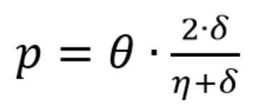
Model and Adaptation of Associative Spiking Neurons
Synaptic efficacy $δ$ and the number $η$ of activations of the presynaptic neuron $N_{m}$ during training of the training sequence set $𝕊$ is used to define synaptic permeability $p$:
OR
Which is finally used to compute synaptic weights:
where $c$ is the synaptic influence: excitatory (c = 1) or inhibitory (c = −1), and m is the multiplication factor modeling the number of synapses connecting the presynaptic and postsynaptic neurons.
Notes:
Next, the synaptic efficacy and the number of activations of the presynaptic neuron for all training sequences is used to compute the synaptic permeabilities for all synapses. The permeability is the core parameter that defines the initial weights of ASN neurons in the ANAKG network. The multiplication factors of all synapses are computed during the fine-tuning process that is introduced in this presentation.

Slide 10
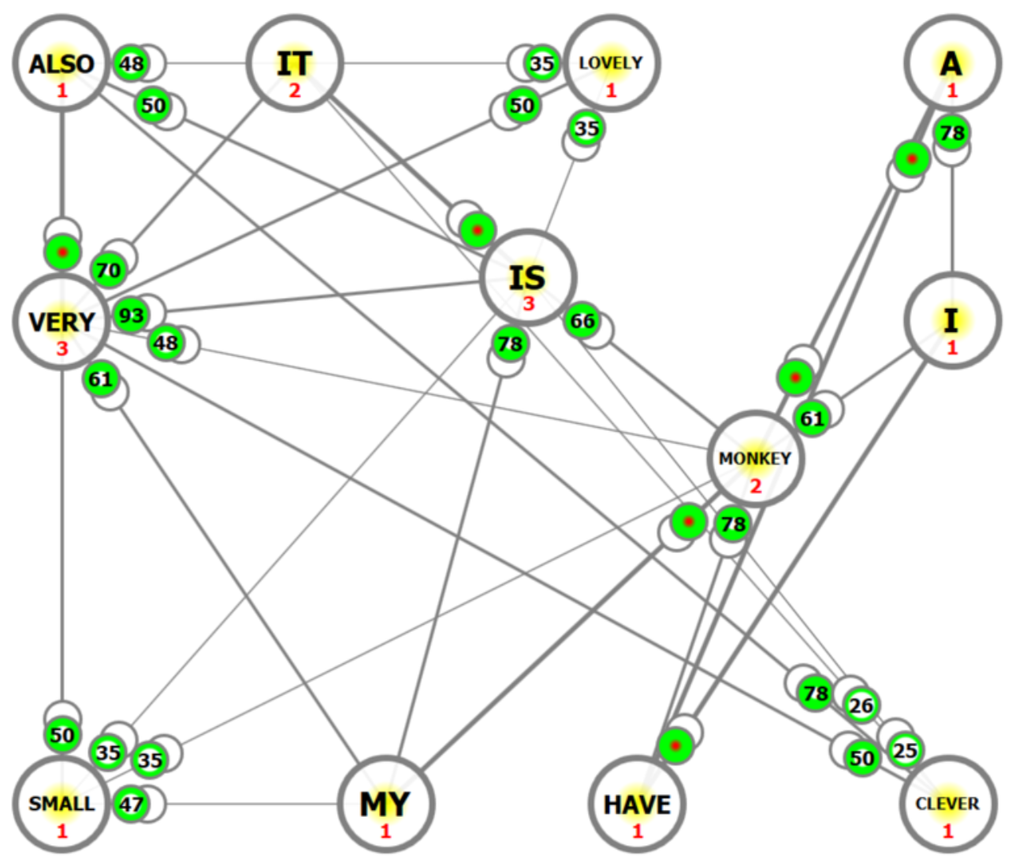
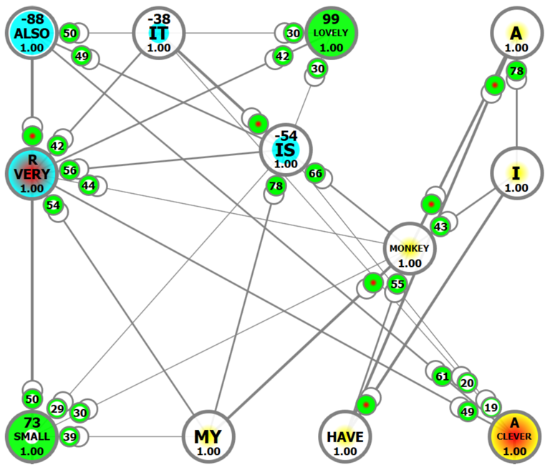
Adaptation and Tuning of Associative Spiking Neurons
The weights computed in a presented way are good enough for the primary set of weights in the complex graph neural networks:
I have a monkey. My monkey is very small. It is very lovely. It is also very clever.
The introduced tuning process allows for the achievement of better recalling results thanks to the slight modification of the multiplication factors of the synapses.
Notes:
In the left figure, the untuned ANAKG network created for the four training sequences has a trouble with recalling the last very correlated training sequence “It is also very clever” correctly.
The fine-tuned ANAKG network on the right after a single tuning cycle recalls all training sequences correctly.

Slide 11
Tuning Process of ANAKG
Two repetitive steps of the tuning process:
All undesired and premature activations of neurons are avoided for all training sequences by using weakening operations.
Conflicts between correlated training sequences are fine-tuned using strengthening operations.
We define: $s_{last}^{charge}$ - the strength of the last stimulus, $x$ – charge level at the moment when the last stimulus came
$x_{all}^{max}$ - the maximum dynamic charge level of each stimulated neuron
$$x_{all}^{max}=\left\{\begin{matrix}x+s_{last}^{charge} if x+s_{last}^{charge}>x_{all}^{max} \\ x_{all}^{max} otherwise \end{matrix}\right.$$
$x_{context}^{max}$ - the previous maximum charge level establishing the context of the last stimulus that should activate the neuron:
$$x_{context}^{max}=x_{all}^{max}−s_{last}^{charge}$$
The correct activation of the neuron assumes that
$$x_{context}^{max}<θ≤x_{context}^{max}+s_{last}^{charge}$$
On this basis we can define strengthening and weakening operations for the tuning process.
Notes:
The correct activation of the neuron assumes that only the last charging stimulus made by the direct predecessor of the element in the training sequence can lift the maximum charging level $x_{all}^{max}$ over the activation threshold θ of this neuron. We also define the undesired and premature activations which must be avoided in the tuning process where multiplication factors are changed.

Slide 12
Weakening Operation
The weakening operation defines how the multiplication factor m decreases when a neuron is activated in the incorrect context or prematurely in the reduced context:
$$γ=\left\{\begin{matrix}\frac{θ}{\left(x_{all}^{max}+ε\right)} for the undesired activations \\ \frac{θ}{\left(x_{context}^{max}+ε\right)} for the premature activations \end{matrix}\right.$$
$$m=m∙γ$$
$$w=c∙p∙m$$
The multiplication factors of the incorrect activations must be deceased to operate on the right stimulation context of the next neurons of the recalled training sequence.
Weakening operations always start and finish the tuning process of the ANAKG network.

Slide 13
Strengthening Operation
The strengthening operation defines how the multiplication factor m increases when a neuron is not activated in the right context of all predecessor of the training sequence or too late:
$$γ=\frac{θ}{x_{all}^{max}−ε}$$
$$m=m∙γ$$
$$w=c∙p∙m$$
The strengthening operation always tries to achieve stimulation of the next sequence element. However, sometimes it is not beneficial if the initial context is not unique, e.g. there are few training sequences which start from the same subsequences of elements.
Strengthening operations allows for recalling of the following elements of the training sequences when the stimulation context is unique.

Slide 14
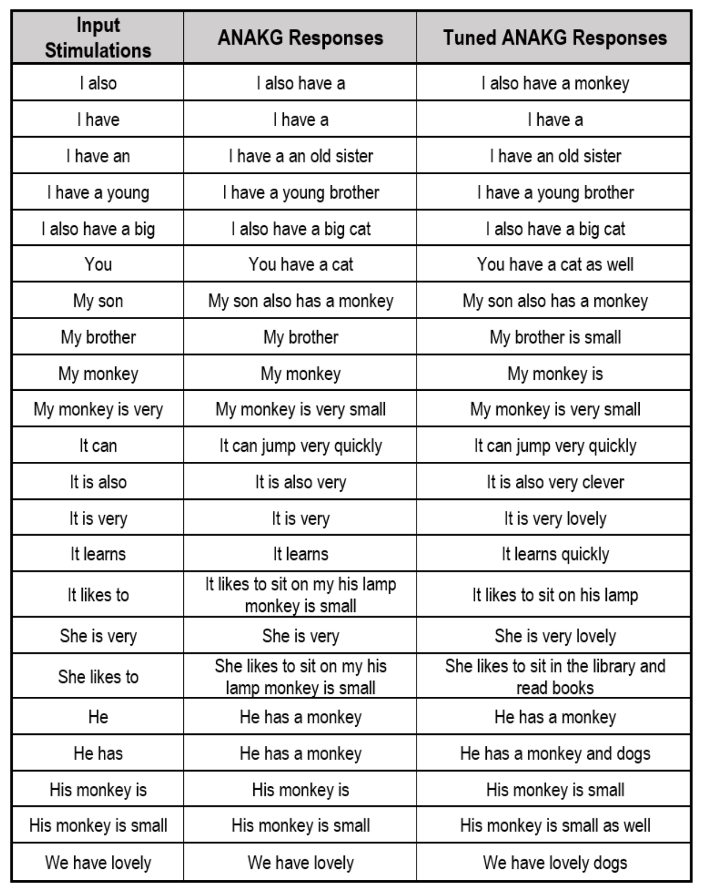
Experimental Results
TRAINING DATA SET:
I have a monkey. My monkey is very small. It is very lovely. It likes to sit on my head. It can jump very quickly. It is also very clever. It learns quickly. My monkey is lovely. I also have a big cat. My son also has a monkey. It likes to sit on his lamp. I have an old sister. She is very lovely. My sister has a small cat. She likes to sit in the library and read books. She quickly learns languages. My sister has a cat. It is very small. You have a cat as well. It is big. I have a young brother. My brother is small. He has a monkey and dogs. His monkey is small as well. We have lovely dogs.
The achieved results confirm that the proposed tuning process is beneficial and produce better-adapted weights allowing to achieved better recalls from the ANAGK network.
Notes:
The experimental results confirm that the proposed…

Slide 15
Conclusions
The presented fine-tuning algorithm adapts weights of the associative pulsing neurons of the ANAKG neural network more accurately and allows to achieve better recalling of training sequences.
Notes:
The experiments on various datasets have shown that the recalling correctness is better when using the presented fine-tuning algorithm.

Slide 16
Questions or Remarks?
A. Horzyk, J. A. Starzyk, J. Graham, Integration of Semantic and Episodic Memories, IEEE Transactions on Neural Networks and Learning Systems, Vol. 28, Issue 12, Dec. 2017, pp. 3084 - 3095, 2017, DOI: 10.1109/TNNLS.2017.2728203.
A. Horzyk, J.A. Starzyk, Fast Neural Network Adaptation with Associative Pulsing Neurons, IEEE Xplore, In: 2017 IEEE Symposium Series on Computational Intelligence, pp. 339 -346, 2017, DOI: 10.1109/SSCI.2017.8285369.
A. Horzyk, Deep Associative Semantic Neural Graphs for Knowledge Representation and Fast Data Exploration, Proc. of KEOD 2017, SCITEPRESS Digital Library, pp. 67 - 79, 2017, DOI: 10.13140/RG.2.2.30881.92005.
A. Horzyk, Neurons Can Sort Data Efficiently, Proc. of ICAISC 2017, Springer-Verlag, LNAI, 2017, pp. 64 - 74, ICAISC BEST PAPER AWARD 2017 sponsored by Springer.
A. Horzyk, J. A. Starzyk and Basawaraj, Emergent creativity in declarative memories, IEEE Xplore, In: 2016 IEEE Symposium Series on Computational Intelligence, Greece, Athens: Institute of Electrical and Electronics Engineers, Curran Associates, Inc. 57 Morehouse Lane Red Hook, NY 12571 USA, 2016, ISBN 978-1-5090-4239-5, pp. 1 - 8, DOI: 10.1109/SSCI.2016.7850029.
Horzyk, A., How Does Generalization and Creativity Come into Being in Neural Associative Systems and How Does It Form Human-Like Knowledge?, Elsevier, Neurocomputing, Vol. 144, 2014, pp. 238 - 257, DOI: 10.1016/j.neucom.2014.04.046.
A. Horzyk, Innovative Types and Abilities of Neural Networks Based on Associative Mechanisms and a New Associative Model of Neurons - Invited talk at ICAISC 2015, Springer-Verlag, LNAI 9119, 2015, pp. 26 - 38, DOI 10.1007/978-3-319-19324-3_3.
A. Horzyk, Human-Like Knowledge Engineering, Generalization and Creativity in Artificial Neural Associative Systems, Springer-Verlag, AISC 11156, ISSN 2194-5357, ISBN 978-3-319-19089-1, ISBN 978-3-319-19090-7 (eBook), Springer, Switzerland, 2016, pp. 39 – 51, DOI 10.1007/978-3-319-19090-7.
Adrian Horzyk
horzyk@agh.edu.pl
Google: Horzyk
Janusz A. Starzyk
starzykj@ohio.edu
Google: Janusz Starzyk
University of Science and Technology in Krakow, Poland
Athens, OH, U.S.A.

